Slide 1

Multidimensional Scaling, Clustering, and Network method Latent Space Model for Social Inference
Yi Chen

Slide 2
Objectives
Introduce the statistical framework of Latent Space Network (LSN) model;
Show an example of using LSN in education using R

Slide 3
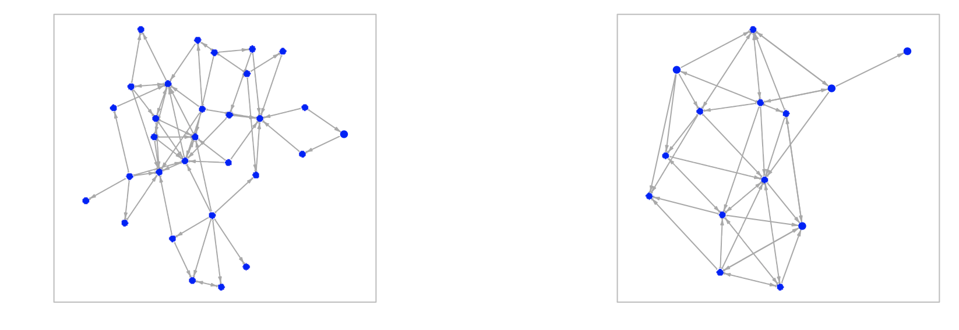
Latent Space Model for Social Inference
Social Inference (also called spillover, contagion or diffusion): individuals become more similar to those with whom they interact or are most closely connected in their social network.

Slide 4
Latent Space Model for Social Inference
Example of delinquency behavior delinquency:
Adolescent’s delinquency behavior may be inferenced by the delinquency behavior of friends and also the delinquency behavior of the popular student (even they are not friend directly)
➔ There is a need to identify the latent influence of the observed and unobserved connections.
At the same time, when there is homophonous selection based on this unobserved risk-taking tendency in the networks, such that adolescents with similar level of risk-taking tendency are more likely to be friends.
➔ The effect of connection in the social network is hard to separate from the effect of other salient individual behavior and unobserved psychological states.
➔ “possibility that there may be non-observed variables co-determining the probabilities of change in network and/or behavior” (Steglich, 2010).
Benefit of using Latent Space Model (LSM) for social inference
Identify the underlying mechanism that generate the observed pattern in social network;
Specify the latent structure, which is able to identify the dependence/inference when there is no direct tie in the observed social network.
The latent structure is also able to represent the unobserved latent co-determining variables.

Slide 5
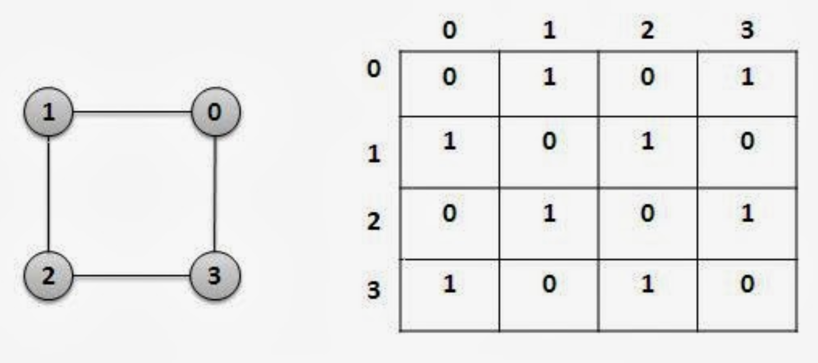
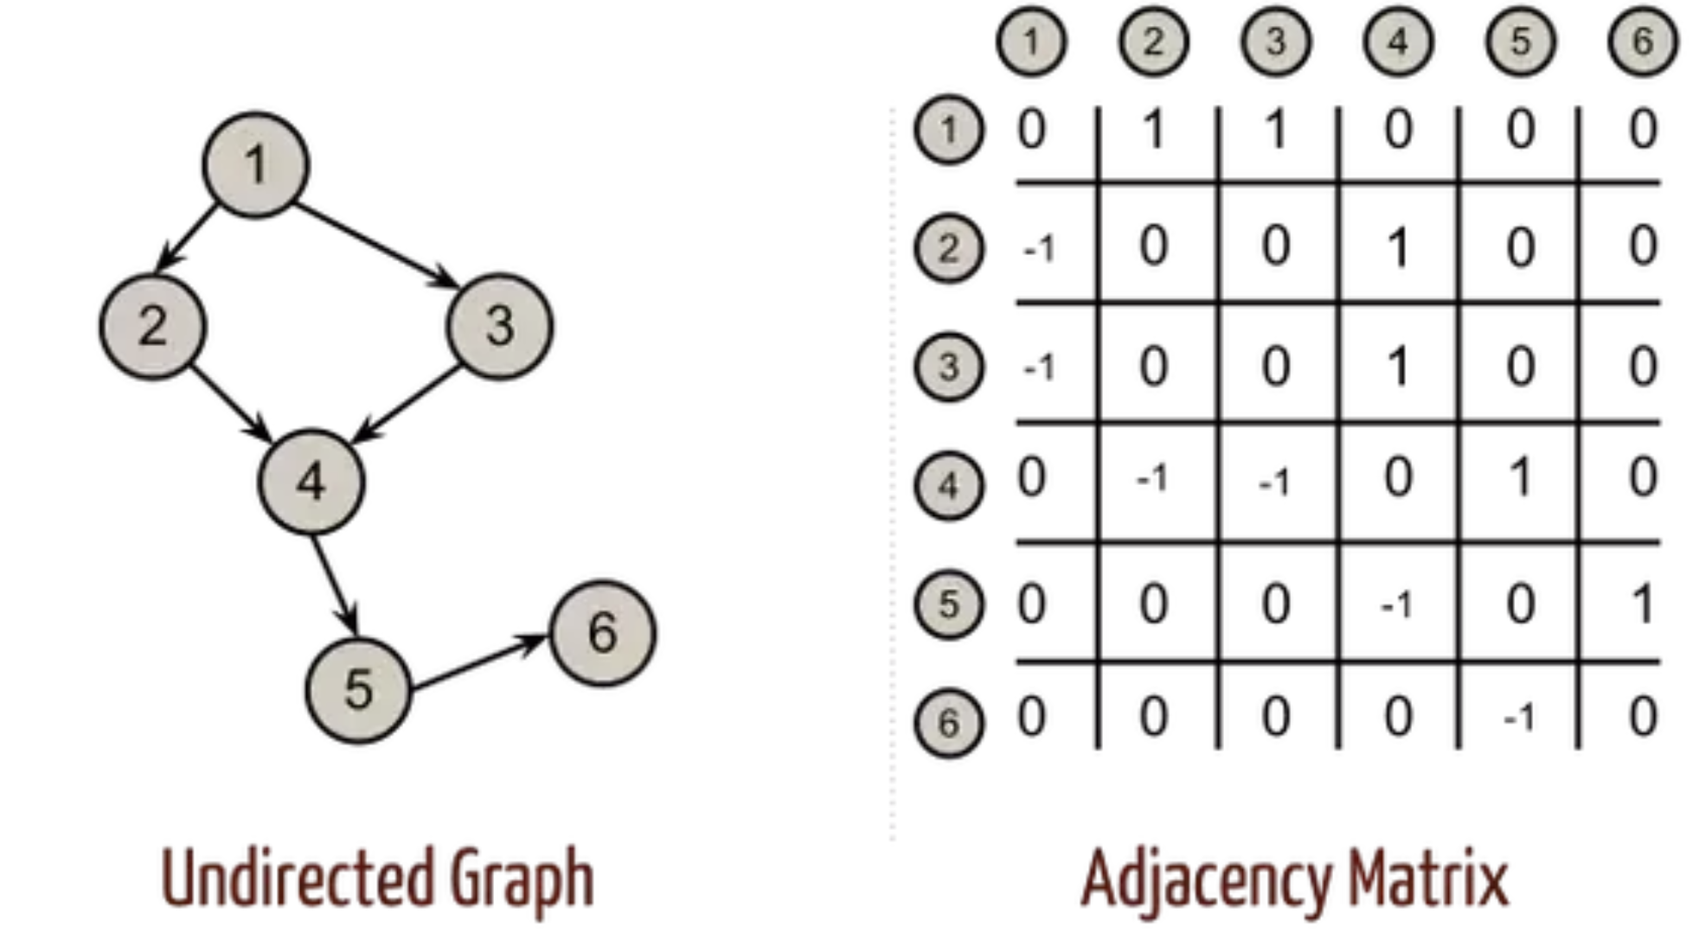
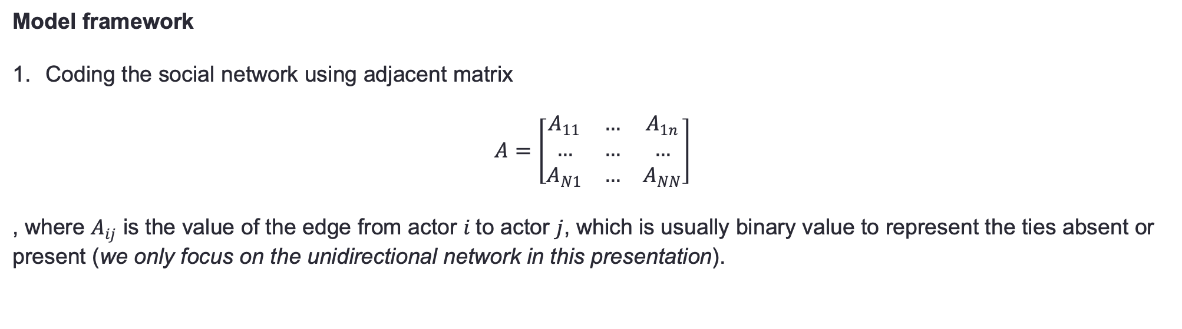
Latent Space Model for Social Inference
Model framework
Coding the social network using adjacent matrix
$$A=\left[\begin{matrix}A_{11} & … & A_{1n} \\ … & … & … \\ A_{N1} & … & A_{NN}\end{matrix}\right]$$
, where $A_{ij}$ is the value of the edge from actor $i$to actor $j$, which is usually binary value to represent the ties absent or present (we only focus on the unidirectional network in this presentation).

Slide 6
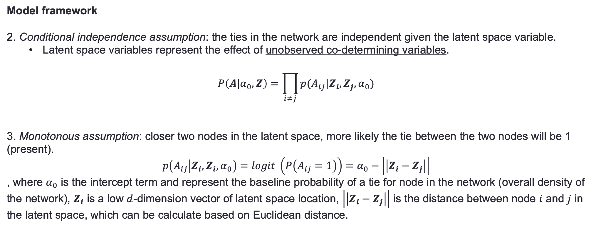
Latent Space Model for Social Inference
Model framework
2. Conditional independence assumption: the ties in the network are independent given the latent space variable.
Latent space variables represent the effect of unobserved co-determining variables.
$$P\left(A | α_{0},Z\right)=\prod_{i≠j}{p(A_{ij}|Z_{i},Z_{j},α_{0})}$$
3. Monotonous assumption: closer two nodes in the latent space, more likely the tie between the two nodes will be 1 (present).
$$p\left(A_{ij} | Z_{i},Z_{i},α_{0}\right)=logit \left(P\left(A_{ij}=1\right)\right)=α_{0}−\left|\left|Z_{i}−Z_{j}\right|\right|$$
, where $α_{0}$ is the intercept term and represent the baseline probability of a tie for node in the network (overall density of the network), $Z_{i}$ is a low $d$-dimension vector of latent space location, $\left|\left|Z_{i}−Z_{j}\right|\right|$ is the distance between node $i$ and $j$ in the latent space, which can be calculate based on Euclidean distance.

Slide 7
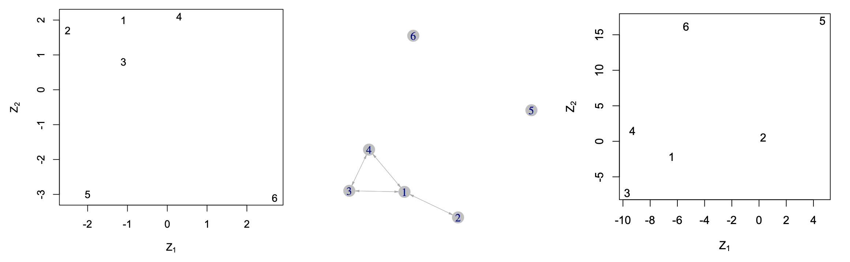
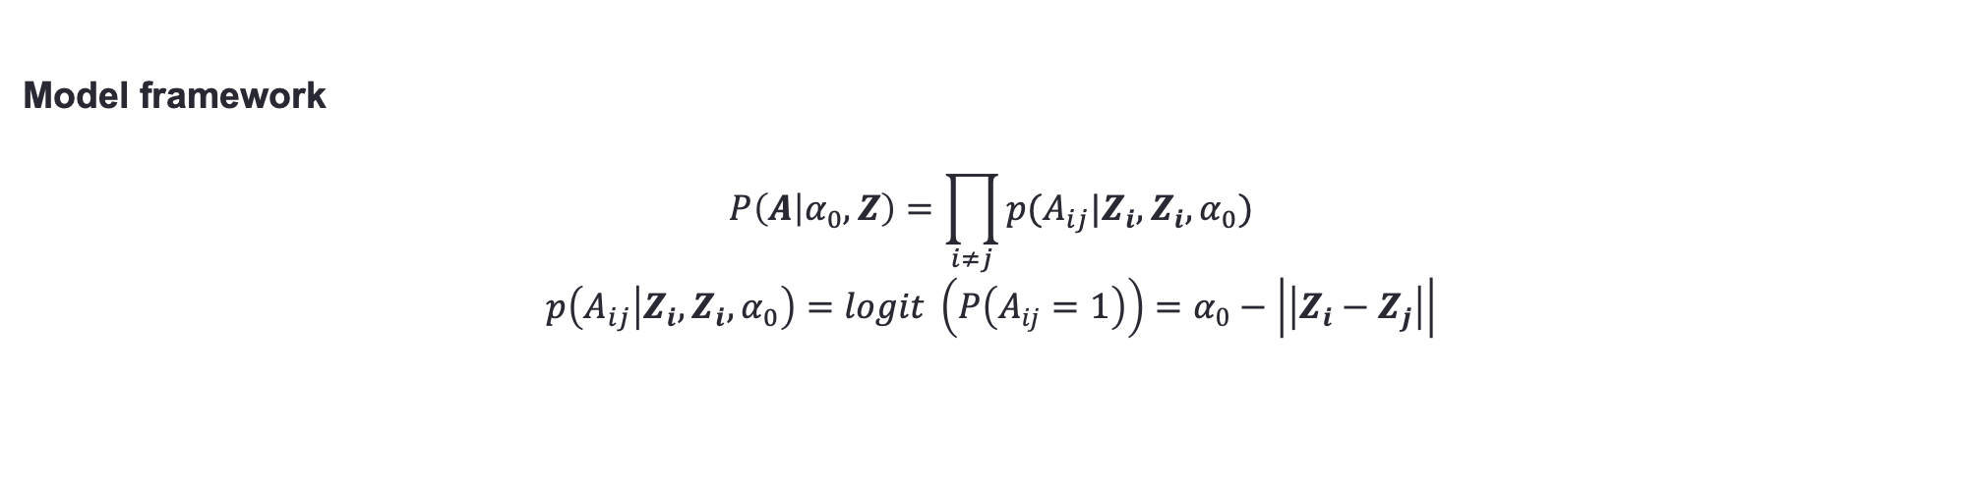
Latent Space Model for Social Inference
Model framework
$$P\left(A | α_{0},Z\right)=\prod_{i≠j}{p(A_{ij}|Z_{i},Z_{i},α_{0})}$$
$$p\left(A_{ij} | Z_{i},Z_{i},α_{0}\right)=logit \left(P\left(A_{ij}=1\right)\right)=α_{0}−\left|\left|Z_{i}−Z_{j}\right|\right|$$
True latent space
Observed Network
Estimated Latent Space

Slide 8
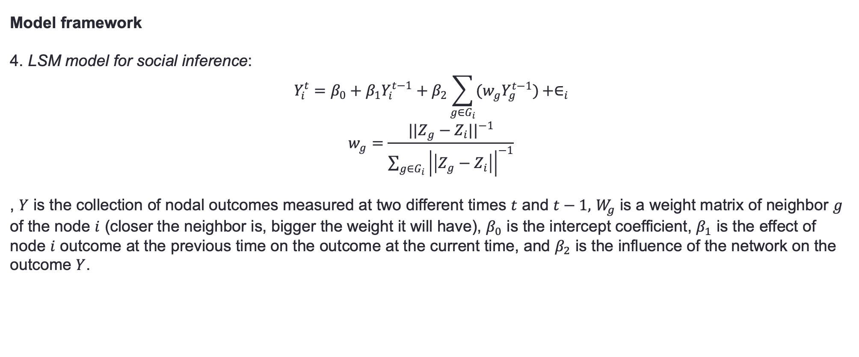
Latent Space Model for Social Inference
Model framework
4. LSM model for social inference:
$$Y_{i}^{t}=β_{0}+β_{1}Y_{i}^{t−1}+β_{2}\sum_{g∈G_{i}}{(w_{g}Y_{g}^{t−1})}+∈_{i}$$
$$w_{g}=\frac{{||Z_{g}−Z_{i}||}^{−1}}{\sum_{g∈G_{i}}{{\left|\left|Z_{g}−Z_{i}\right|\right|}^{−1}}}$$
, $Y$ is the collection of nodal outcomes measured at two different times $t$ and $t−1,$ $W_{g}$ is a weight matrix of neighbor $g$ of the node $i$ (closer the neighbor is, bigger the weight it will have), $β_{0}$ is the intercept coefficient, $β_{1}$ is the effect of node $i$ outcome at the previous time on the outcome at the current time, and $β_{2}$ is the influence of the network on the outcome $Y$.

Slide 9
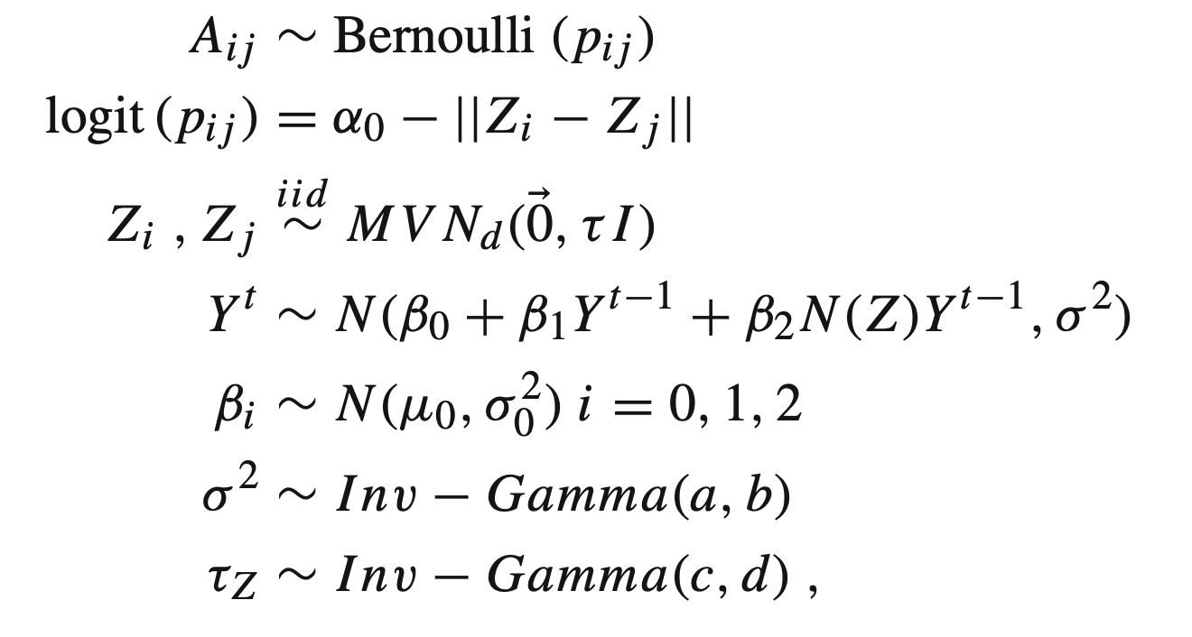
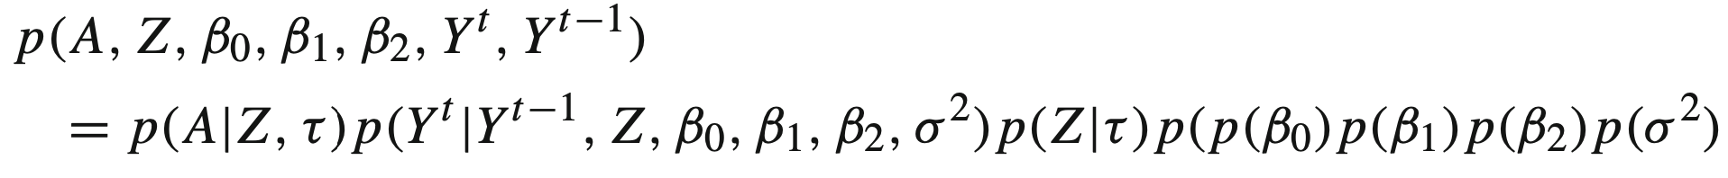
Latent Space Model for Social Inference
Bayesian Framework of model (Rjags or Stan in R)
The joint posterior distribution can be written as

Slide 10
LSM example
Data Set
Source: Teenage Friends and Lifestyle Study data set (Michell 2000, Pearson and West 2003).
https://www.stats.ox.ac.uk/~snijders/siena/s50_data.htm
Component:
Friendship network: Friendship network data and substance use were recorded for a cohort of 50 female pupils in a school in the West of Scotland.
The panel data were recorded over a three year period starting in 1995, when the pupils were aged 13, and ending in 1997.
The friendship networks were formed by allowing the pupils to name up to twelve best friends.
Pupils were also asked about their attributes on smoking (s), drug use (d), sport (sp), and alcohol use (a).

Slide 11
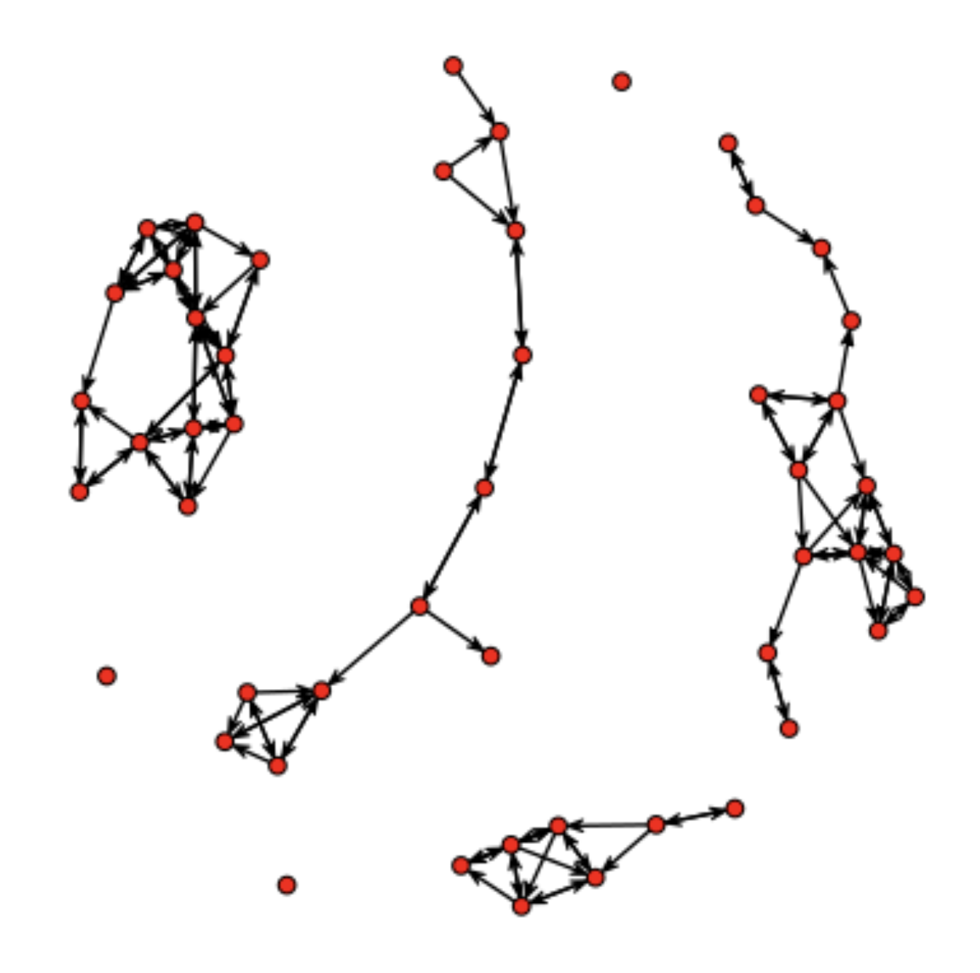
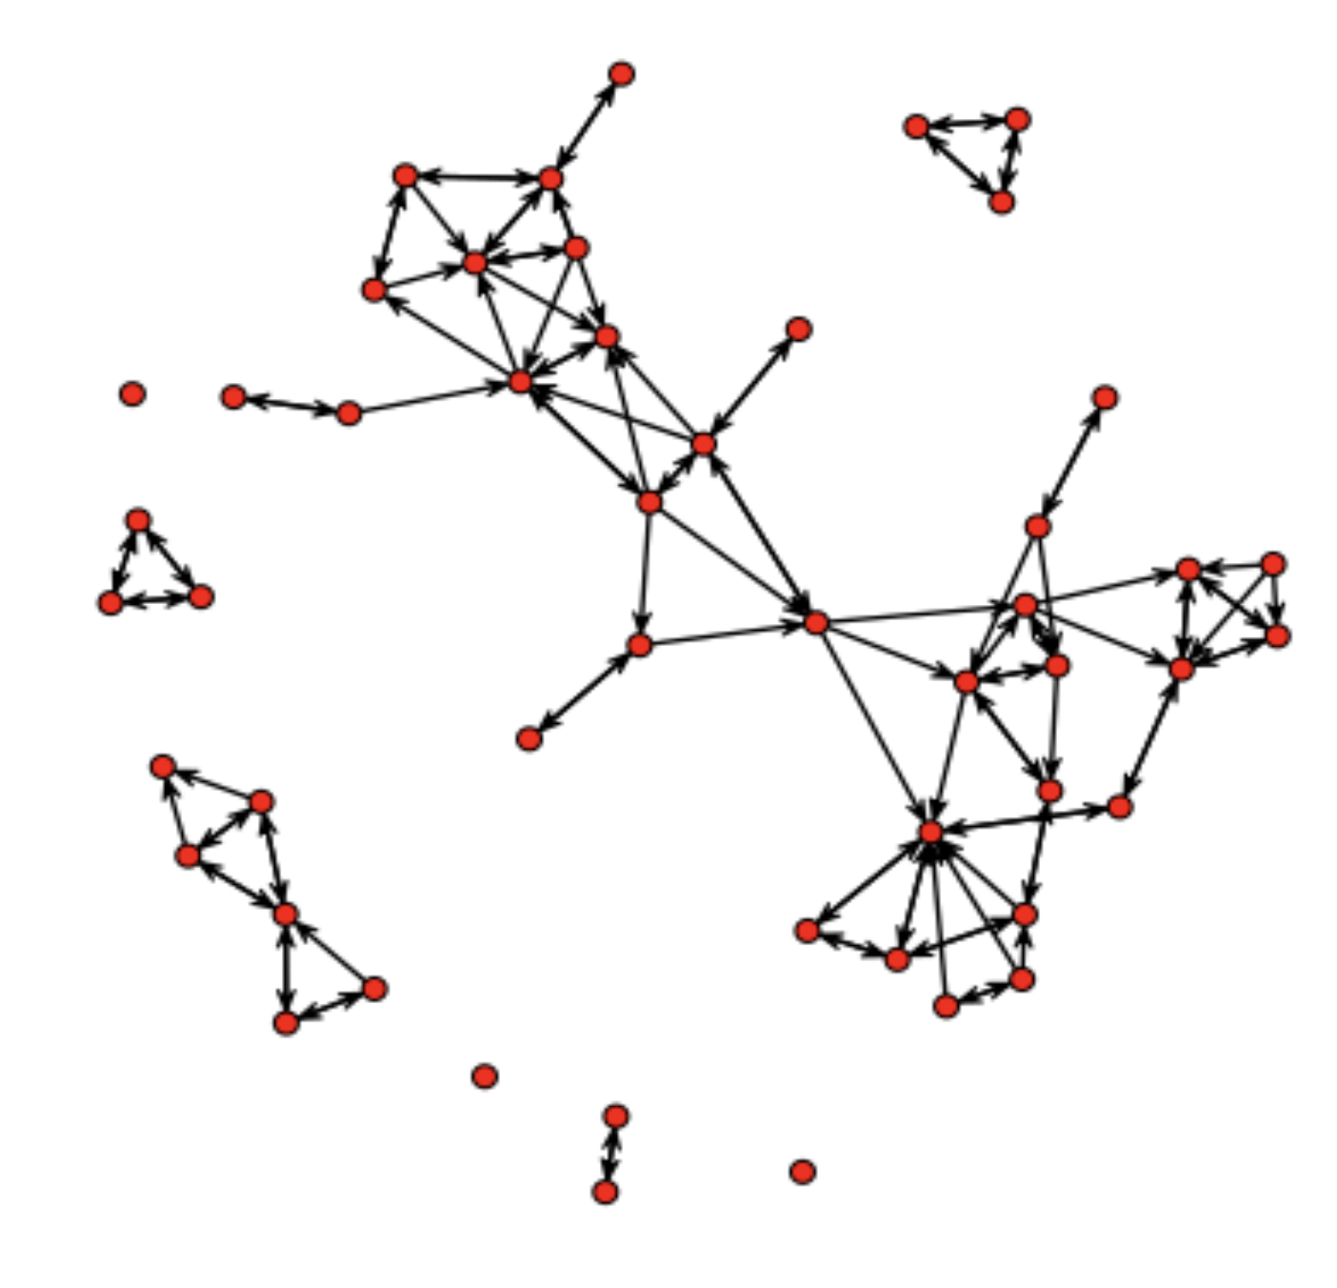
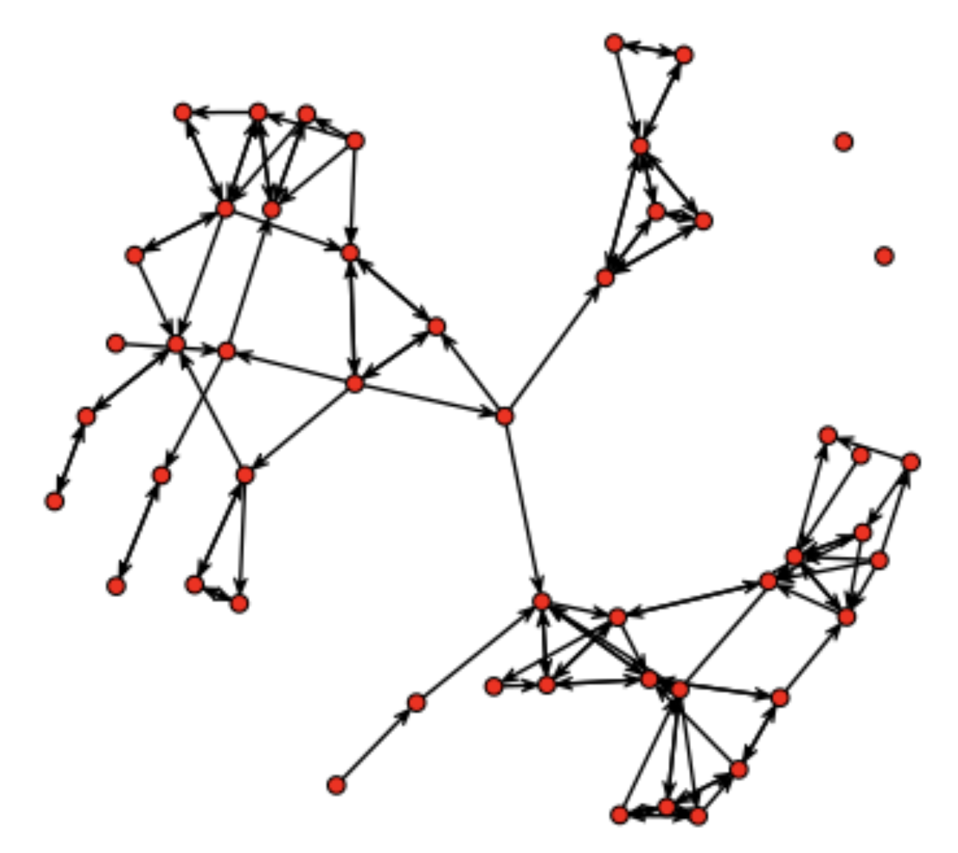
LSM example
Girls’ friendship network from 1995 to 1997

Slide 12
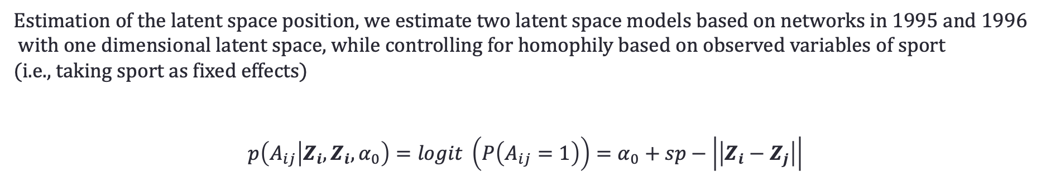
LSM example
Estimation of the latent space position, we estimate two latent space models based on networks in 1995 and 1996
with one dimensional latent space, while controlling for homophily based on observed variables of sport
(i.e., taking sport as fixed effects)
$$p\left(A_{ij} | Z_{i},Z_{i},α_{0}\right)=logit \left(P\left(A_{ij}=1\right)\right)=α_{0}+sp−\left|\left|Z_{i}−Z_{j}\right|\right|$$
library(latentnet)
m1<-ergmm(g1 ~ euclidean(d=1)+absdiff("sp"),control=ergmm.control(sample.size=5000,burnin=20000,interval=10,Z.delta=5))
m1<-ergmm(g2 ~ euclidean(d=1)+absdiff("sp"),control=ergmm.control(sample.size=5000,burnin=20000,interval=10,Z.delta=5))
note:
g1 and g2 are network for year 1995 and 1996 associated with the attribute a, s, sp, and d for each note.
ergmm for for fit latent space model
euclidean(d=1) means the latent space is one dimension
absdiff for calculate the absolute difference

Slide 13
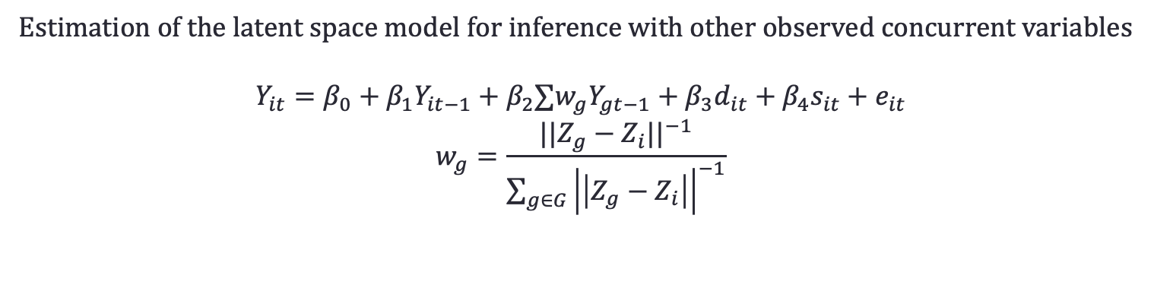
LSM example
Estimation of the latent space model for inference with other observed concurrent variables
$$Y_{it}=β_{0}+β_{1}Y_{it−1}+β_{2}∑w_{g}Y_{gt−1}+β_{3}d_{it}+β_{4}s_{it}+e_{it}$$
$$w_{g}=\frac{{||Z_{g}−Z_{i}||}^{−1}}{\sum_{g∈G}{{\left|\left|Z_{g}−Z_{i}\right|\right|}^{−1}}}$$
In this example, outcome of interest is attribute towards alcohol (a), other observed concurrent variables
are their attribute towards drug (d) and smoke (s). Variables sport (sp) has been used in the last step to capture the
friendship network and will be ignored in this step.
summary(lm(alcohol~lag_alc+w+smoke+drug,data=infl))
note:
lag_alc is the alcohol is the previous year
w is the weighted sum of alcohol for the neighbors, which is based on the latent position estimated in the last step.
smoke and drug are two controlling variables

Slide 14
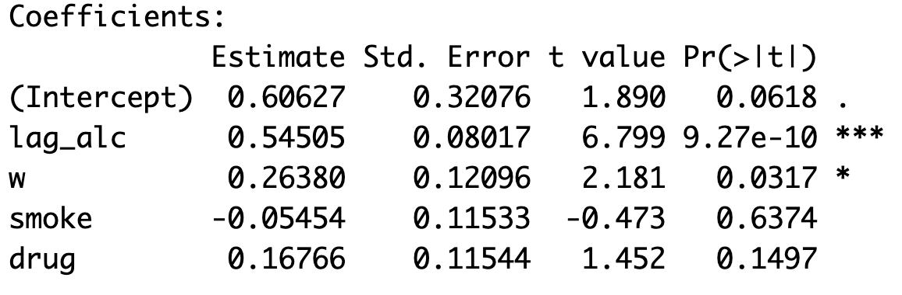
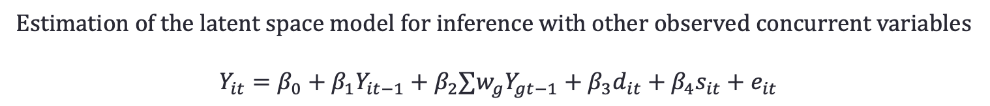
LSM example
Estimation of the latent space model for inference with other observed concurrent variables
$$Y_{it}=β_{0}+β_{1}Y_{it−1}+β_{2}∑w_{g}Y_{gt−1}+β_{3}d_{it}+β_{4}s_{it}+e_{it}$$
the effect of social inference (w) in this example is 0.264 and significant

Slide 15
R code
m1<-ergmm(g1 ~ euclidean(d = 1)+absdiff("sp"),control=ergmm.control(sample.size=5000,burnin=20000,interval=10,Z.delta=5))
m2<-ergmm(g2 ~ euclidean(d = 1)+absdiff("sp"),control=ergmm.control(sample.size=5000,burnin=20000,interval=10,Z.delta=5))
latent_pos_1 <- m1$mkl$Z
latent_pos_2 <- m2$mkl$Z
w <- c()
for (i in 1:50){
current_position <- latent_pos_2[i]
neighbor_alcho <- s50a[,2][-i]
neighbor <- latent_pos_2[-i]
distances <- c()
for (j in neighbor){ distances <- c(distances,1/abs(current_position-j)) }
cur_w <- 0
for (k in 1:length(distances)){ cur_w <- cur_w + (distances[k] / sum(distances)) * neighbor_alcho[k] }
w <- c(w,cur_w)
}
for (i in 1:50){
current_position <- latent_pos_1[i]
neighbor_alcho <- s50a[,1][-i]
neighbor <- latent_pos_1[-i]
distances <- c()
for (j in neighbor){distances <- c(distances,1/abs(current_position-j)) }
cur_w <- 0
for (k in 1:length(distances)){cur_w <- cur_w + (distances[k] / sum(distances)) * neighbor_alcho[k] }
w <- c(w,cur_w)
}
alcohol<-c(s50a[,3],s50a[,2])
lag_alc<-c(s50a[,2],s50a[,1])
drug<-c(s50d[,3],s50d[,2])
smoke<-c(s50s[,3],s50s[,2])
infl<-data.frame(cbind(alcohol,lag_alc,w,drug,smoke,rep(c(1:50),2),rep(c(1:2),each=50)))
summary(lm(alcohol~lag_alc+w+smoke+drug,data=infl))
library(RSiena)
library(latentnet)
s50s<-read.table("s50-smoke.dat",header=FALSE)
s50d<-read.table("s50-drugs.dat",header=FALSE)
s50sp<-read.table("s50-sport.dat",header=FALSE)
s50a<-read.table("s50-alcohol.dat", header=FALSE)
g1<-network(s501,directed=TRUE)
g1%v%"a" <- s50a[,1]
g1%v%"s" <- s50s[,1]
g1%v%"sp" <- s50sp[,1]
g1%v%"d" <- s50d[,1]
g2<-network(s502,directed=TRUE)
g2%v%"a" <- s50a[,2]
g2%v%"s" <- s50s[,2]
g2%v%"sp" <- s50sp[,2]
g2%v%"d" <- s50d[,2]
g3<-network(s503,directed=TRUE)
g3%v%"a" <- s50a[,3]
g3%v%"s" <- s50s[,3]
g3%v%"sp" <- s50sp[,3]
g3%v%"d" <- s50d[,3]
plot(g1)
plot(g2)
plot(g3)

Slide 16
Reference
Sweet, T. and Adhikari S. (2020). A Latent Space Network Model for Social Influence. Psychometrika, https://doi.org/10.1007/s11336-020-09700-x.
Xu, R. (2019) Estimating Social Influence Using Latent Space Adjusted Approach in R. arXiv preprint, https://arxiv.org/abs/1903.05999.

Slide 17
Thank you

